Slide 1
Direct Charge Portal Training
San Bernardino Auditor-Controller/Treasurer/Tax Collector
6/24-26/2025
Carol Hall

Slide 2
Outline
Review important dates/deadlines
Portal Demonstration
Logging in
Requesting access to your agency/subagency
Uploading and submitting files
Reporting
Question and Answer session
Direct Charge Portal Training

Slide 3
Important Dates
Direct Charge Portal Training

Slide 4
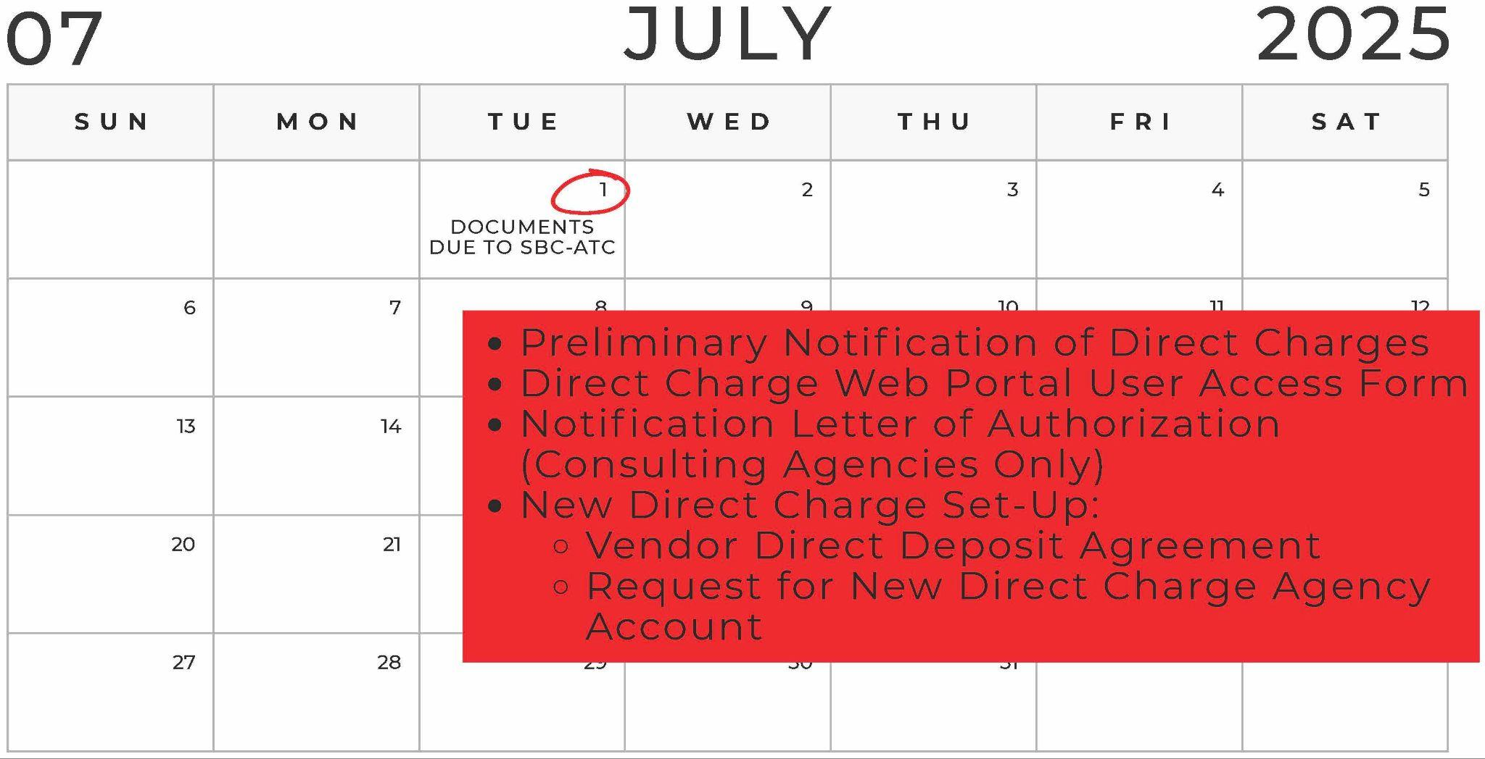
Important Dates
Direct Charge Portal Training

Slide 5
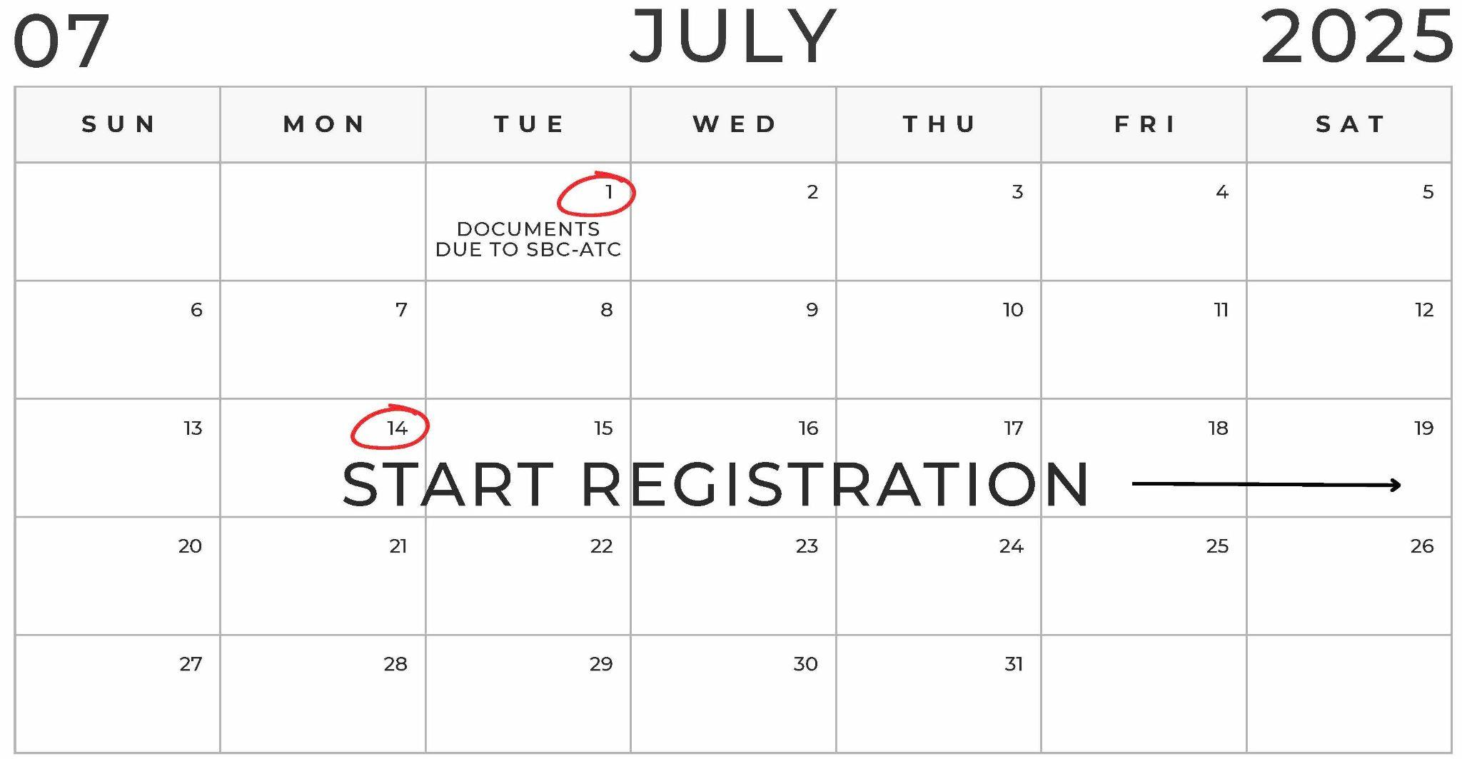
Important Dates
Direct Charge Portal Training

Slide 6
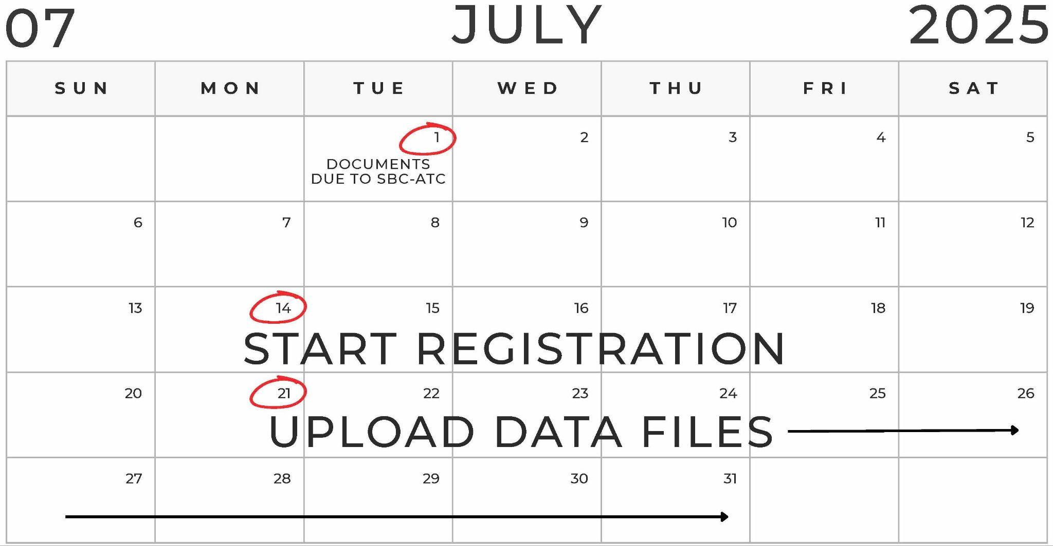
Important Dates
Direct Charge Portal Training

Slide 7
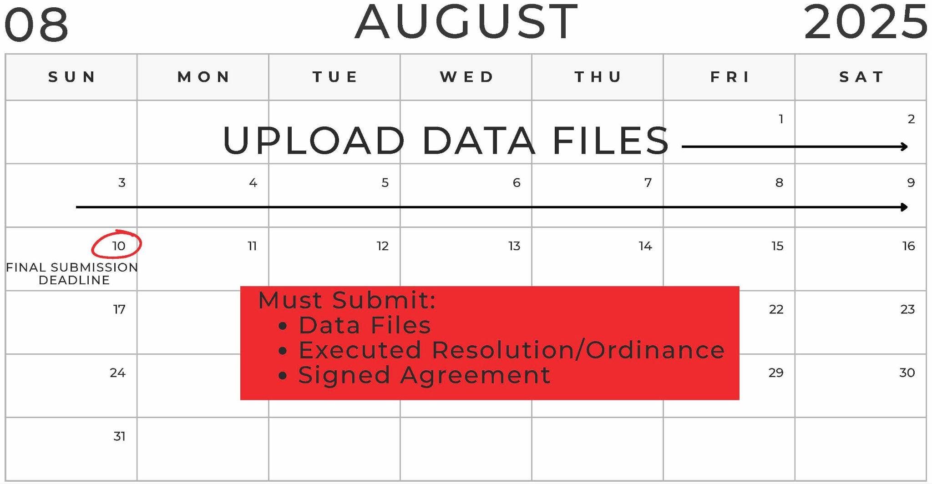
Important Dates
Direct Charge Portal Training

Slide 8
Demonstration
Direct Charge Portal Training

Slide 9
ptassessments@sbcountyatc.gov

